Slide 1
DIFFERENT TYPE OF CABLE NETWORK
What is the cable network ?
Networking cable is a piece of networking hardware used to connect one network device to other network devices or to connect two or more computers to share devices such as printers or scanners.

Slide 2
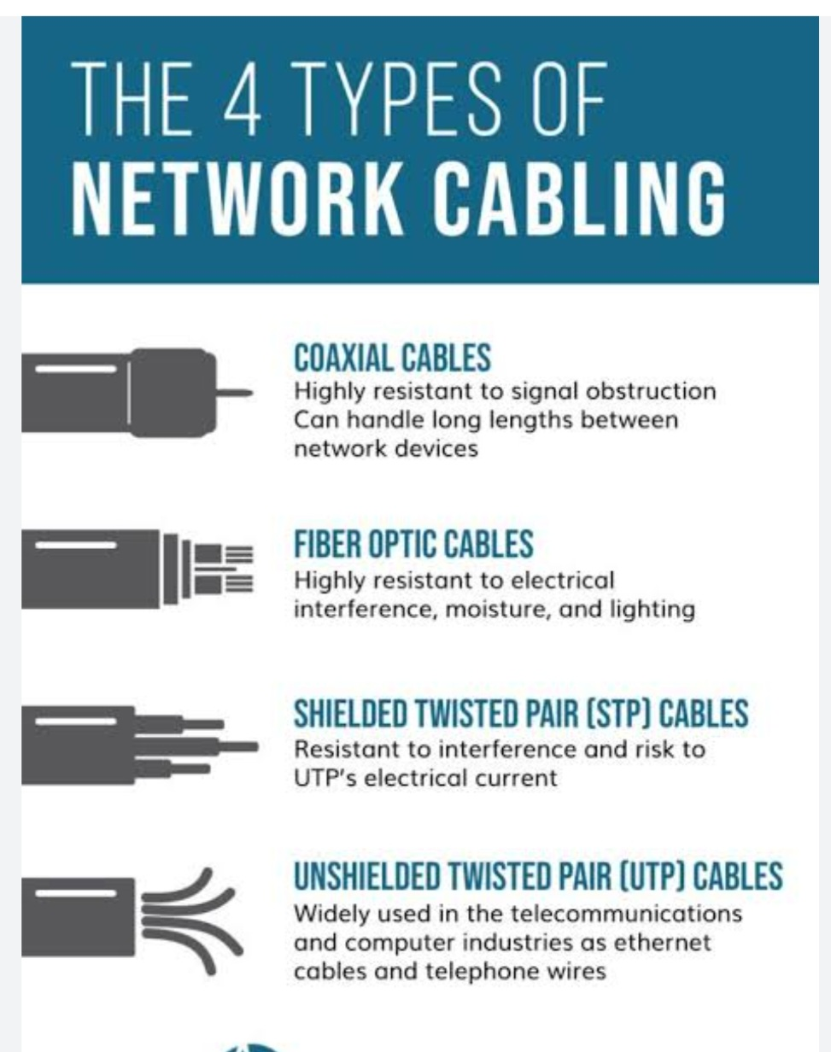
TYPE OF CABLE NETWORK?
Network cables can be divided Into four types:- Coaxial, Shielded twisted pair(STP), Unshielded twisted pair (UTP), or Fibre optic cable.

Slide 3
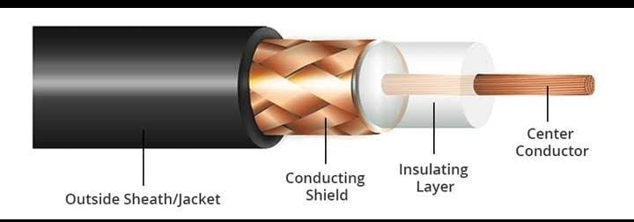
Coaxial Cables:-
Coaxial cable contain a centre conductor and a metal shield insulated by a plastic layer placed in between. The metal shield in coaxial cables blocks any elements or interferences from the outside.
In a coaxial cable the outer layer known as sheath, protects the cable from physical damage. Meanwhile, the metal shield protects the cable from any external interference, and the insulation between the metal shield and the conductor protects the conductor the core of the coaxial cable.
Coaxial cable conductors carry electromagnetic signals and can come either in single core Or multi core models. While a single coaxial cable has only one central metal, multi core cables have many metal wires.
Coaxial cables were used in the earlier days of computer networks.

Slide 4
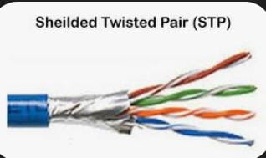
Shielded Twisted Pair Cables:-
These ethernet cables also known as STP cables, are widely used for business installations. They were developed for computer networks and are an excellent choice for areas with high interference. Shielded twisted pair cables are also used to expand any distance between cables.
STP cables consist of coloured wires twisted around one another, forming pairs. Usually, shielded twisted pair cables are composed of four colourful pairs of wires wrapped with metal shields and a singular plastic sheath.

Slide 5
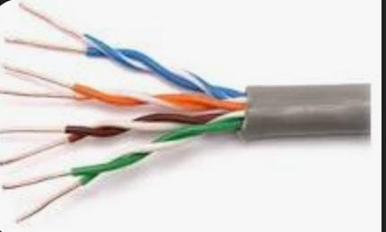
Unshielded Twisted Pair Cables:-
Unshielded twisted Pair cables, or UTP cables, are widely used in industrial computers and telecommunication companies. The conductors present in UTP cables form a circuit that stops any EMI. Similarly to STP cables, Unshielded twisted pairs are colourful wires wrapped around each other and then wrapped altogether in a plastic sheath.
When compared to STP cables, UTP are more affordable.

Slide 6
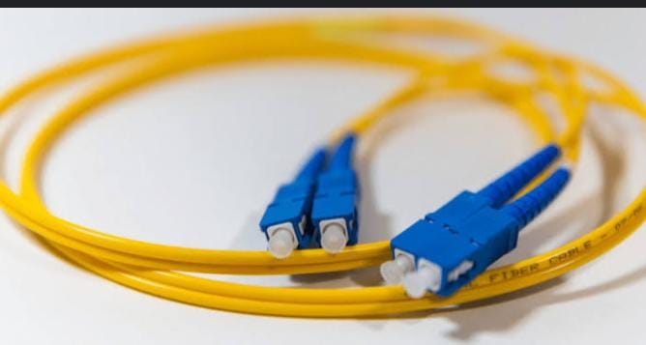
Fibre Optic cables:-
Fibre optic cables are networking cables that contain either a glass or a plastic core, shielded by a cladding, a buffer and a jacket. These layers protect Fibre optic cables from potential damage and from external interference. This networking cable is the perfect choice for carrying data around long distances and the standard cable for connecting networks in different locations.
Fibre optic cable can be single mode Fibre or multi mode Fibre. SMF cables support longer distances, while MMF cables carry more data.

